Slide 1
JAVASCRIPT

Slide 2
JavaScript Syntax
JavaScript can be implemented using JavaScript statements that are placed within the <script>... </script> HTML tags in a web page.
<script ...>
JavaScript code
</script>
JavaScript with type attribute:
<script type="text/javascript">
JavaScript code
</script>
Where to place JavaScript?
JavaScript can be placed in the <head> section of an HTML page.
JavaScript can be placed in the <body> section of an HTML page.
JavaScript can also be placed in external files and then linked to HTML Page.

Slide 3
Simple syntax of JavaScript
<!DOCTYPE html>
<html>
<body>
<h2>JavaScript in Body</h2>
<h1 id="demo"></h1>
<script>
document.getElementById("demo").innerHTML = "My First JavaScript";
</script>
</body>
</html>

Slide 4
Simple syntax of JavaScript
<!DOCTYPE html>
<html>
<body>
<h1>My First Web Page</h1>
<p>My first paragraph.</p>
<script>
document.write(5 + 6);
</script>
</body>
</html>

Slide 5
Variables
<!DOCTYPE html>
<html>
<body>
<p id="demo"></p>
<script>
var pi = 3.14;
var person = "John Doe";
document.getElementById("demo").innerHTML =
pi + "<br>" + person ;
</script>
</body>
</html>

Slide 6
Arrays
<!DOCTYPE html>
<html>
<body>
<h2>JavaScript Arrays</h2>
<p id="demo"></p>
<script>
var cars = ["Saab","Volvo","BMW"];
document.getElementById("demo").innerHTML = cars[0];
</script>
</body>
</html>

Slide 7
What is an operator?
Let us take a simple expression 4 + 5 is equal to 9. Here 4 and 5 are called operands and ‘+’ is called the operator.
JavaScript supports the following types of operators.
 Assignment operators
 Comparison operators
 Arithmetic operators
 Bitwise operators
 Bitwise shift operators
 Logical operators
 Conditional (ternary) operator

Slide 8
<!DOCTYPE html>
<html>
<body>
<h2>JavaScript Booleans</h2>
<p id="demo"></p>
<script>
var x = 5;
var y = 5;
var z = 6;
document.getElementById("demo").innerHTML = (x == y) + "<br>" + (x == z);
</script>
</body>
</html>

Slide 9
Declarations of functions in JavaScript
<!DOCTYPE html>
<html>
<body>
<h1>JavaScript Functions</h1>
<p id="demo"></p>
<script>
function myFunction(p1, p2) {
return p1 * p2;
}
document.getElementById("demo").innerHTML = myFunction(4,5);
</script>
</body>
</html>

Slide 10
JavaScript in the Head Section
<!DOCTYPE html>
<html>
<head>
<script>
function abc()
{
document.getElementById("ab").innerHTML = "LPU expects some better placements out of you";
}
</script>
</head>
<body>
<p id="ab">Welcome to LPU</p>
<input type="submit" onclick="abc()">
</body>
</html>

Slide 11
JavaScript in Body Section
<!DOCTYPE html>
<html>
<head>
</head>
<body>
<p id="abc">Welcome to LPU</p>
<input type="submit" onclick="abc()">
<script>
function abc()
{
document.getElementById("abc").innerHTML = "LPU expects some better placements out of you";
}
</script>
</body>
</html>
NB: It is a good idea to place scripts at the bottom of the <body> element. This can improve page load, because script compilation can slow down the display.

Slide 12
External JavaScript (b.js)
function abc()
{
document.getElementById("abc").innerHTML = "LPU expects some better placements out of you";
}
a.html
<!DOCTYPE html>
<html>
<head>
<script src=“b.js"></script>
</head>
<body>
<p id="abc">Welcome to LPU</p>
<input type="submit" onclick="abc()">
</body>
</html>
.

Slide 13
Objects
<!DOCTYPE html>
<html>
<body>
<p>Creating a JavaScript Object.</p>
<p id="demo"></p>
<script>
var car = {type:"Fiat", model:"500", color:"white"};
document.getElementById("demo").innerHTML = car.type+" "+car.model+" "+car.color;
</script>
</body>
</html>

Slide 14
JavaScript Dialog Boxes
JavaScript supports three important types of dialog boxes. These dialog boxes can be used to raise and alert, or to get confirmation on any input or to have a kind of input from the users.
Alert Dialog Box
An alert dialog box is mostly used to give a warning message to the users. For example, if one input field requires to enter some text but the user does not provide any input, then as a part of validation, you can use an alert box to give a warning message.
Nonetheless, an alert box can still be used for friendlier messages. Alert box gives only one button "OK" to select and proceed.

Slide 15
Example
<!DOCTYPE html>
<html>
<body>
<h2>JavaScript Alert</h2>
<button onclick="myFunction()">Try it</button>
<script>
function myFunction() {
alert("I am an alert box!");
}
</script>
</body>
</html>

Slide 16
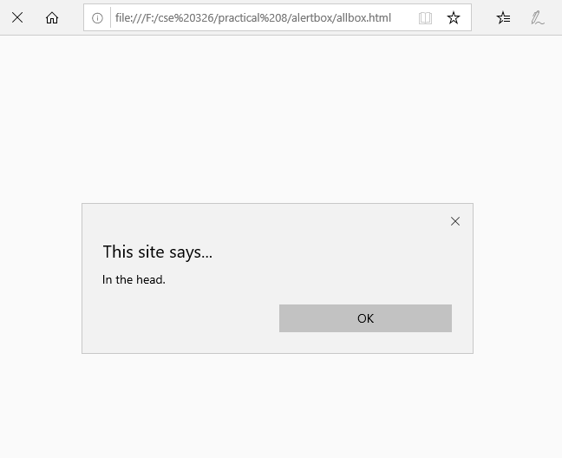

Slide 17
Confirmation Dialog Box
A confirmation dialog box is mostly used to take user's consent on any option. It displays a dialog box with two buttons: OK and Cancel.
If the user clicks on the OK button, the window method confirm() will return true. If the user clicks on the Cancel button, then confirm() returns false.

Slide 18
<!DOCTYPE html>
<html>
<head>
<title>confirmbox</title>
</head>
<body>
<script>
var query=confirm ("you want to delete this file?");
if(query)
document.write("welcome to javascript.<br/> file Deleted!");
else
document.write("welcome to javascript.<br/> file Not Deleted!");
</script>
</body>
</html>
Example

Slide 19
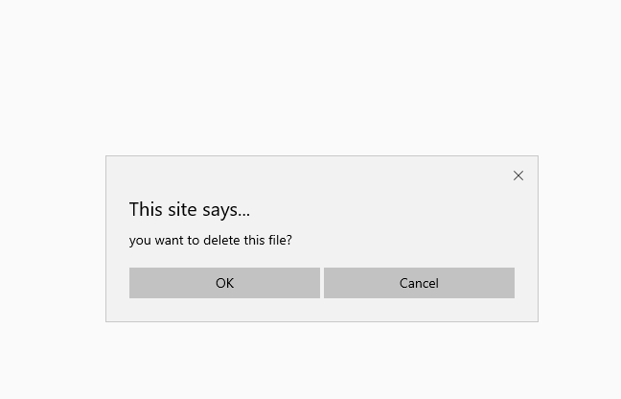
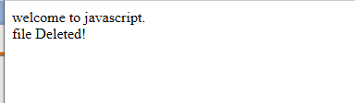

Slide 20
Prompt Dialog Box
The prompt dialog box is very useful when you want to pop-up a text box to get user input. Thus, it enables you to interact with the user. The user needs to fill in the field and then click OK.
This dialog box is displayed using a method called prompt() which takes two parameters:
a label which you want to display in the text box and
a default string to display in the text box.
This dialog box has two buttons: OK and Cancel. If the user clicks the OK button, the window method prompt() will return the entered value from the text box. If the user clicks the Cancel button, the window method prompt()returns null.

Slide 21
Example
<!DOCTYPE html>
<html>
<body>
<h2>JavaScript Prompt</h2>
<p id="demo"></p>
<script>
var txt;
var person = prompt("Please enter your name:", "Enter Name");
if (person == null || person == "") {
txt = "User cancelled the prompt.";
} else {
txt = "Hello " + person + "! How are you today?";
}
document.getElementById("demo").innerHTML = txt;
</script>
</body>
</html>

Slide 22
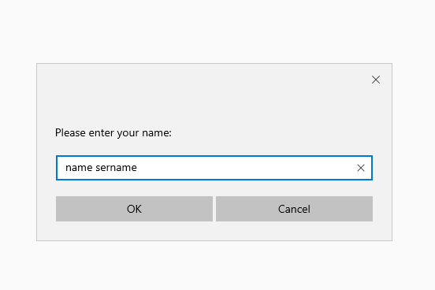
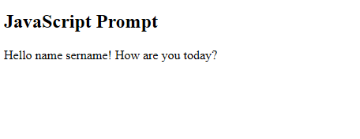

Slide 23
Conditional Statements
Very often when you write code, you want to perform different actions for different decisions.
You can use conditional statements in your code to do this.
In JavaScript we have the following conditional statements:
Use if to specify a block of code to be executed, if a specified condition is true
Use else to specify a block of code to be executed, if the same condition is false
Use else if to specify a new condition to test, if the first condition is false
Use switch to specify many alternative blocks of code to be executed

Slide 24
Different Kinds of Loops
JavaScript supports different kinds of loops:
for - loops through a block of code a number of times
while - loops through a block of code while a specified condition is true
do/while - also loops through a block of code while a specified condition is true

Slide 25
For-Loop
<!DOCTYPE html>
<html>
<body>
<h1>JavaScript Loops</h1>
<p id="demo"></p>
<script>
var text = "";
var i;
for (i = 0; i < 5; i++) {
text += "The number is " + i + "<br>";
}
document.getElementById("demo").innerHTML = text;
</script>
</body>
</html>

